Slide 1
NATIONAL DEFENSE UNIVERSITY FOUNDATION
A Force Multiplier
August 1, 2022
Innovation and Excellence for National Security and Global Peace
Notes:
What is NDUF, why, mission, we’re embedded in NDU
Rebuilding, sample programs/NDU
What the foundation can do that NDU can’t ($, awareness to help NDU obj, logos, facilitate, etc)
Call to action, WIFM

Slide 2
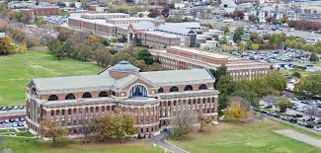
Our Mission:
Supporting NDU Excellence & Innovation
The National Defense University Foundation (NDU Foundation) secures funding and resources to support the academic and professional development programs for senior military and diplomatic leaders attending the National Defense University.
The Foundation creates excellence and innovation among the faculty and student body through external partnerships, financial support and original initiatives.
The National Defense University (NDU) Foundation is a nonpartisan, nonprofit 501(c)3 philanthropic foundation.
Innovation and Excellence for National Security and Global Peace

Slide 3
Our Mission: A Closer Look
Forging Partnerships
The NDU Foundation engages military and diplomatic senior leaders with private sector thought leaders and subject matter experts within and across the national security industrial complex.
Creating Best-in-Class Learning and Professional Development
NDU Foundation drives vital support and resources to National Defense University for the sole purpose of ensuring NDU remains a world-class university offering a best-in-class approach to senior leader development for the nation and our allies.
Ensuring Excellence and Mission Success
Our efforts are fueled by the understanding of the important role public-private partnerships play in our national security and defense ecosystem. Together with our supporters, NDUF provides much needed resources to foster faculty excellence, support student success, build international relationships, and improve NDU.
Innovation and Excellence for National Security and Global Peace
Notes:
I’d recommend a slide to follow the includes NDU images with the talking point that “Our mission is YOU.”

Slide 4
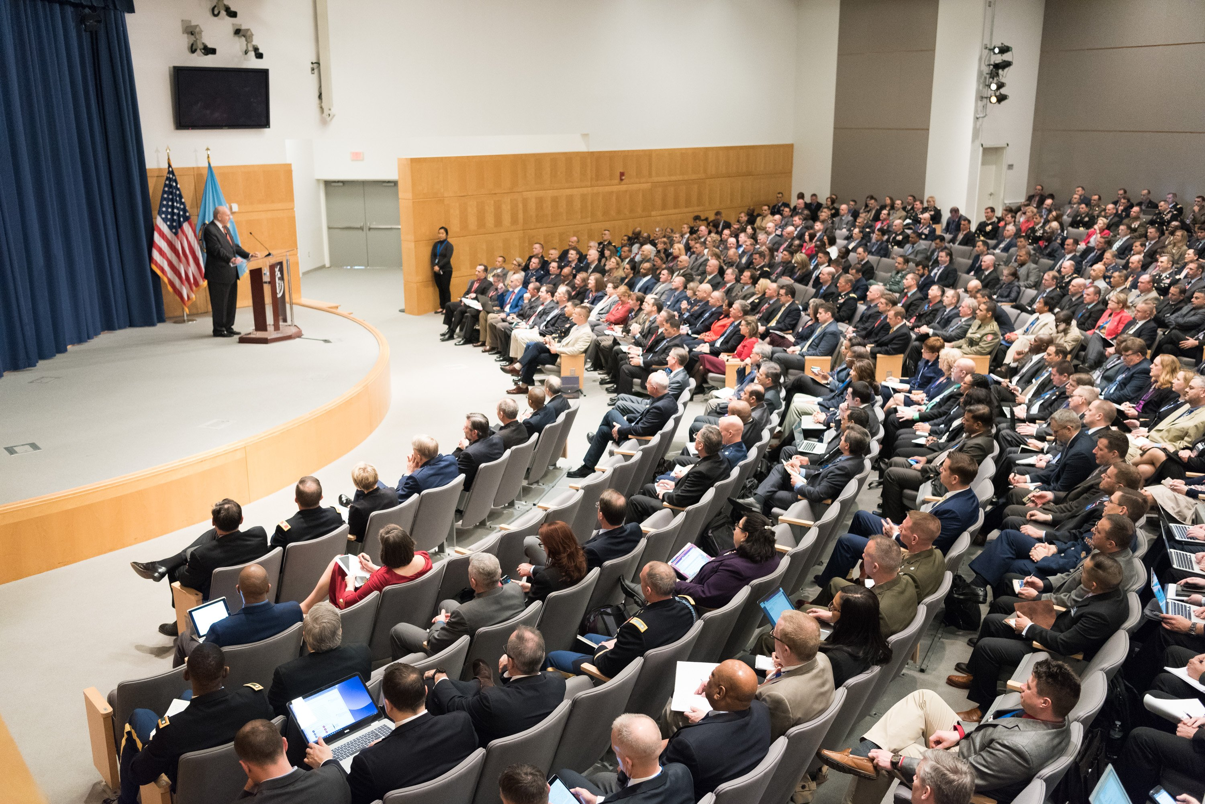
NDU Foundation Priority Areas
Faculty Excellence, including support of research to benefit the productivity and teaching excellence of NDU faculty;
Student Success, including support for student papers, research, and publications to enhance student learning opportunities and outcomes;
International Relationships, including support for the International Student Management Office and the College of International Student Affairs to build strong international relationships with national security leaders from our allies, partners, and friends engaged with NDU, and engage current students and alumni;
Improving the University including acquiring technology to improve teaching, learning, and the infrastructure of the university to support national security education and outreach.
Innovation and Excellence for National Security and Global Peace

Slide 5
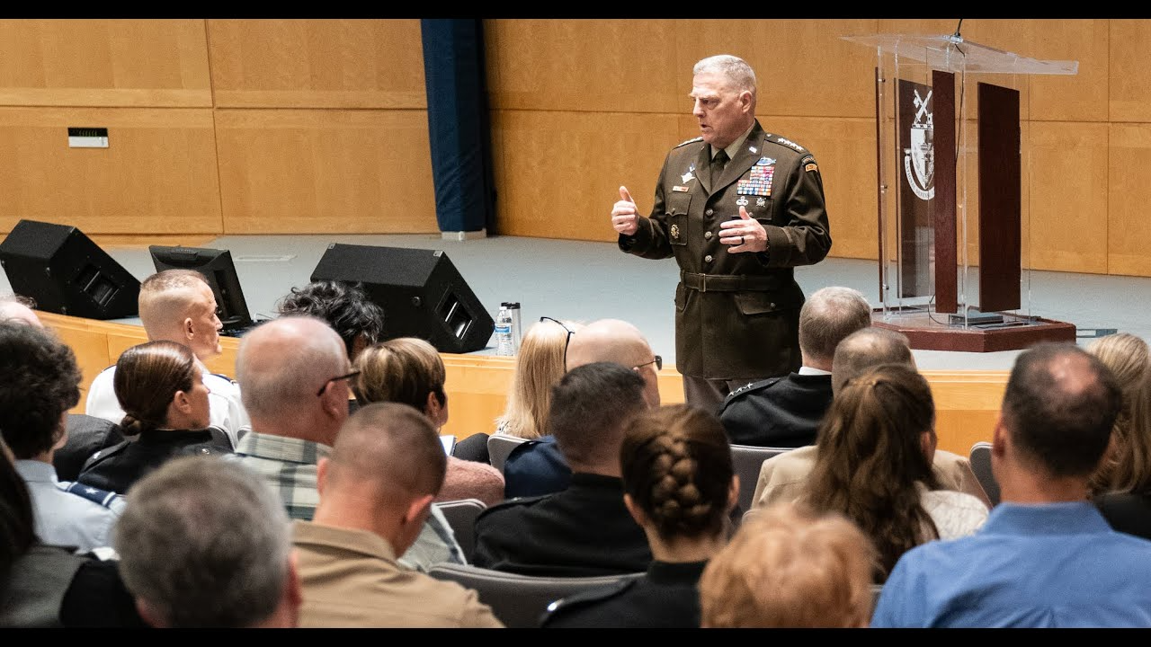
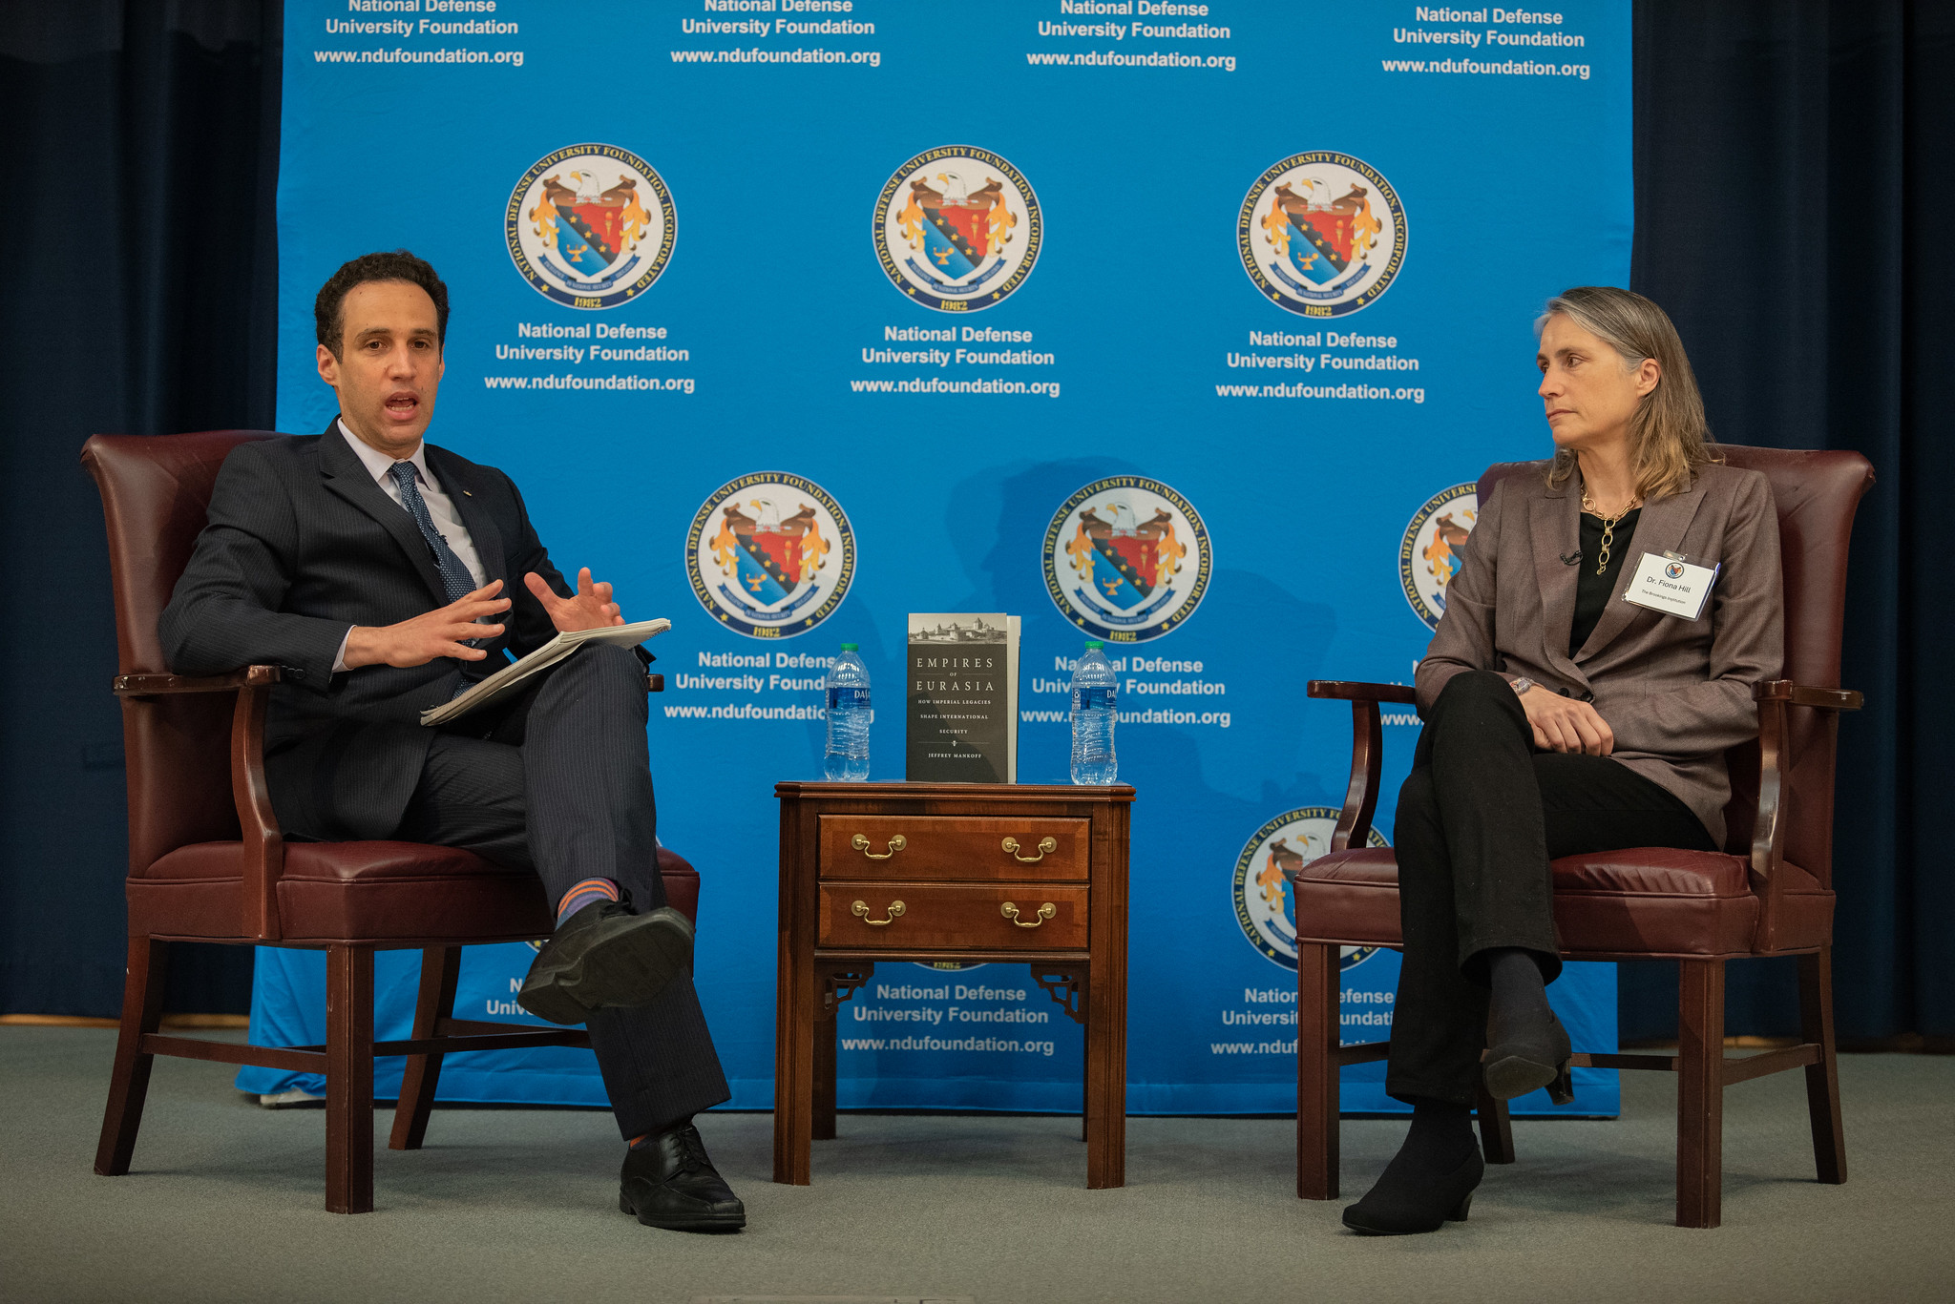
NDF Foundation Flagship Programs
McNair Partners
Chairman’s Advisory Group
National Security Briefings
Innovation Forums
Faculty Publications, Research & Book Signings
American Patriot Dinner
Innovation and Excellence for National Security and Global Peace
Notes:
“Rebuilding, sample programs/NDU”
Include language about building a modern, diverse board,
Focus on programming that brings the leaders in innovation to campus…

Slide 6
Collaboration and
Partnership Opportunities
Funding travel & events for students and faculty to engage with industry
Funding ISMO programs to build international relationships
Endowing Centers of Excellence, faculty and student research, and academic/industry chairs
Providing programmatic support via webinars, forums and strategic communications
Innovation and Excellence for National Security and Global Peace

Slide 7
Connect with Us
Events, News and National Security Briefings Archive
https://ndufoundation.org/
Share research, articles and industry engagement opportunities
Follow Social Media
Twitter @NDUFoundation
LinkedIn NDUF_LinkedIn
Facebook #NDUFoundation
James Schmeling
President & CEO
schmeling@ndufoundation.org
Eugenia Gardner
Vice President Strategic Communications
eugenia@communispr.com
Innovation and Excellence for National Security and Global Peace

